Slide 1
fib Young Members Group of Ukraine
fib National Group of Ukraine
Convener: Vlad Shekhovtsov

Slide 2
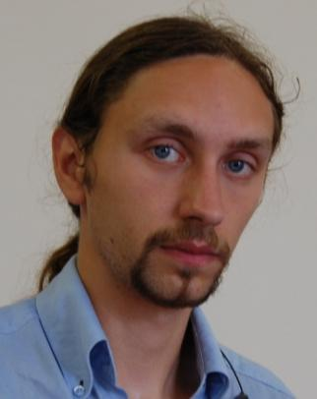
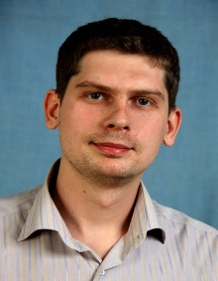
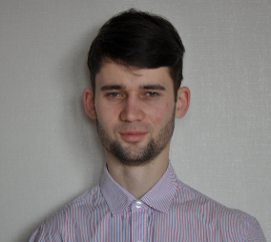
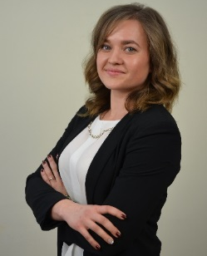
STARTING OF FIB YMG IN UKRAINE
The FIRST Steps:
1-st Ukraine Skype Meeting was held 06 Feb. 2019
Results:
Elected board of the fib Ukrainian Young Members Group;
Coordinator from FIB NG of Ukraine FIB YMG
Fesenko Oleg – Ph.D, NIISK (Kyiv)
Chairman of Ukraine FIB YMG
Shekhovtsov Vladyslav – Ph.D, Odesa State Academy of Civil Engineering and Architecture (Odesa)
Deputy chair of Ukraine FIB YMG
Malakhov Viktor – Ph.D, Odesa State Academy of Civil Engineering and Architecture (Odesa)
Secretary of Ukraine FIB YMG
Petrova Olena – Ph.D, O.M.Beketov National University of Urban Economy (Kharkiv)

Slide 3
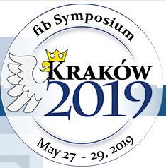
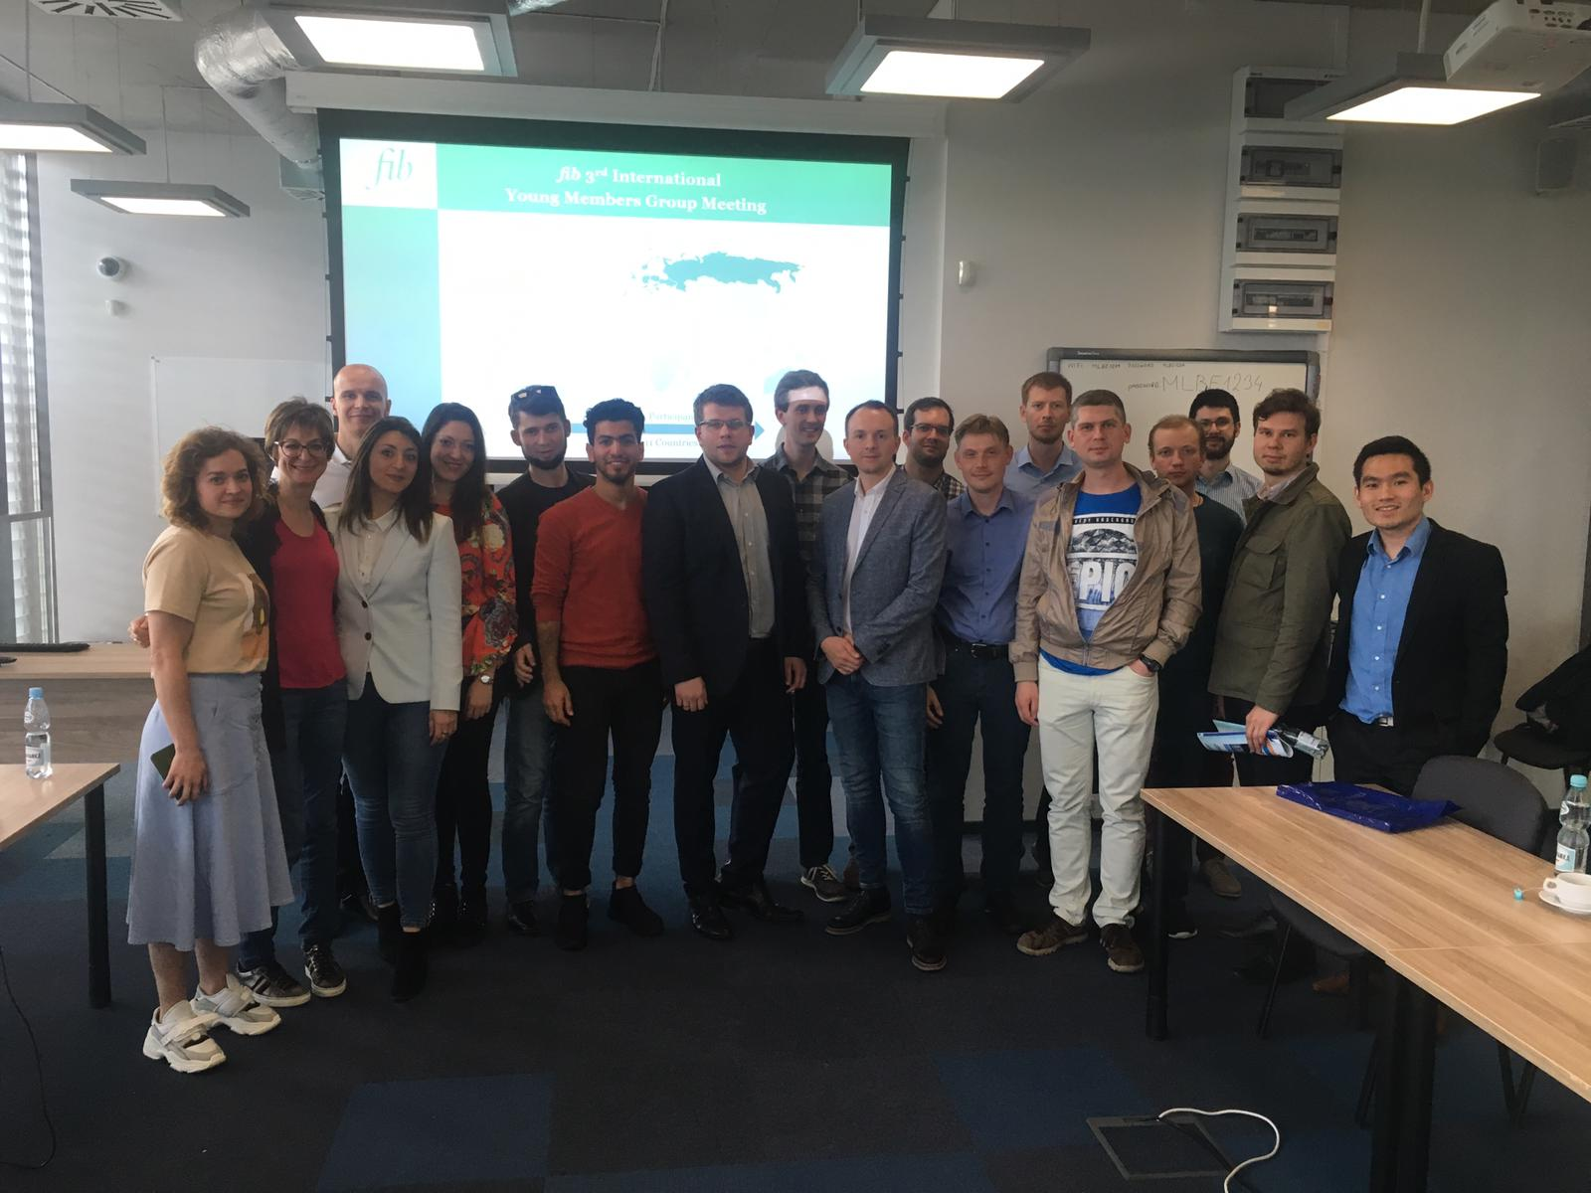
PARTICIPATED IN YMG MEETING IN KRAKOW, POLAND. MAY 2019

Slide 4
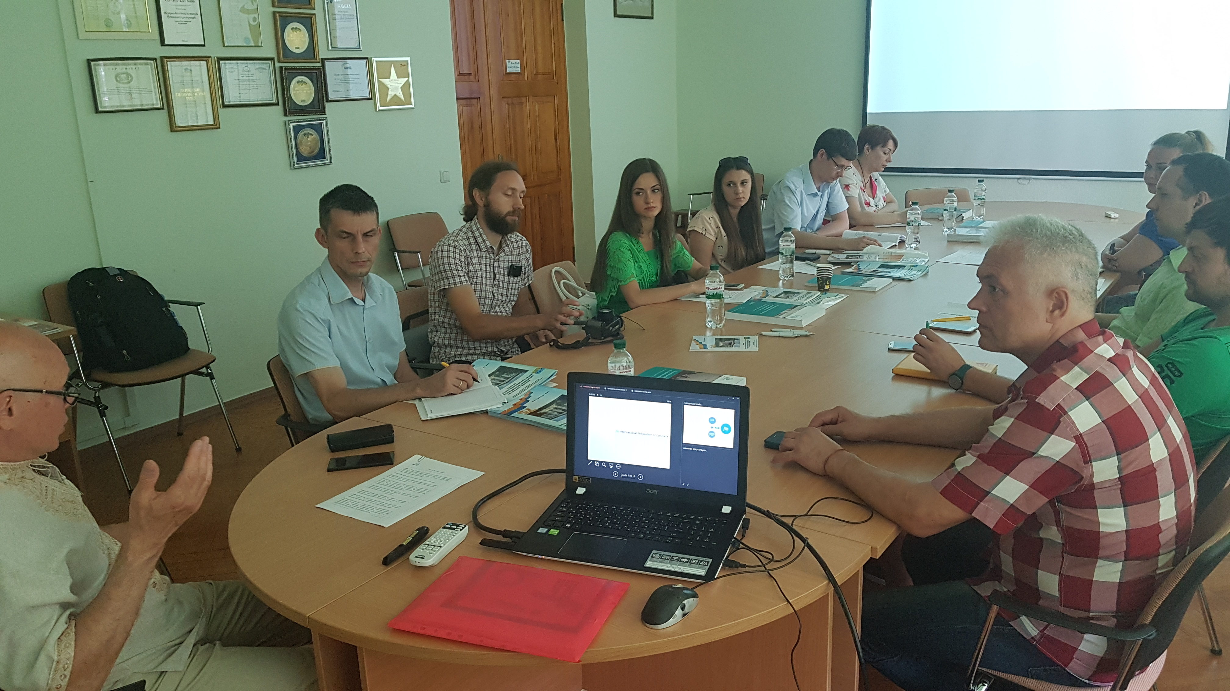
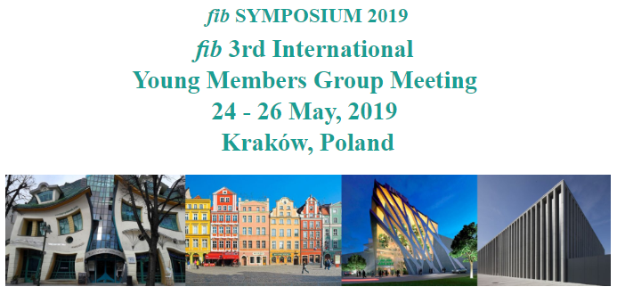
First in-person meeting FIB YMG Ukraine (Kyiv city)
After FIB Symposium in Krakow (Poland) MAY 2019
Discussion:
Mission and goals of FIB International
New generation of Civil Engineers: fib YMG International
(based on 3d Meeting in Krakow 24-26 May, 2019)
- Experience of participating in fib Symposium in Krakow (review of symposia and discussing the most interesting presentations)

Slide 5
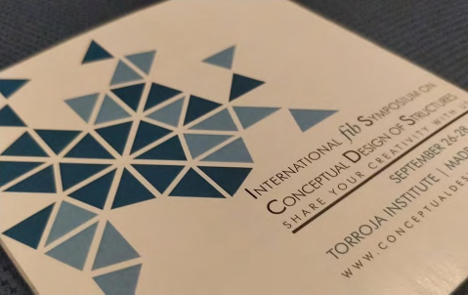
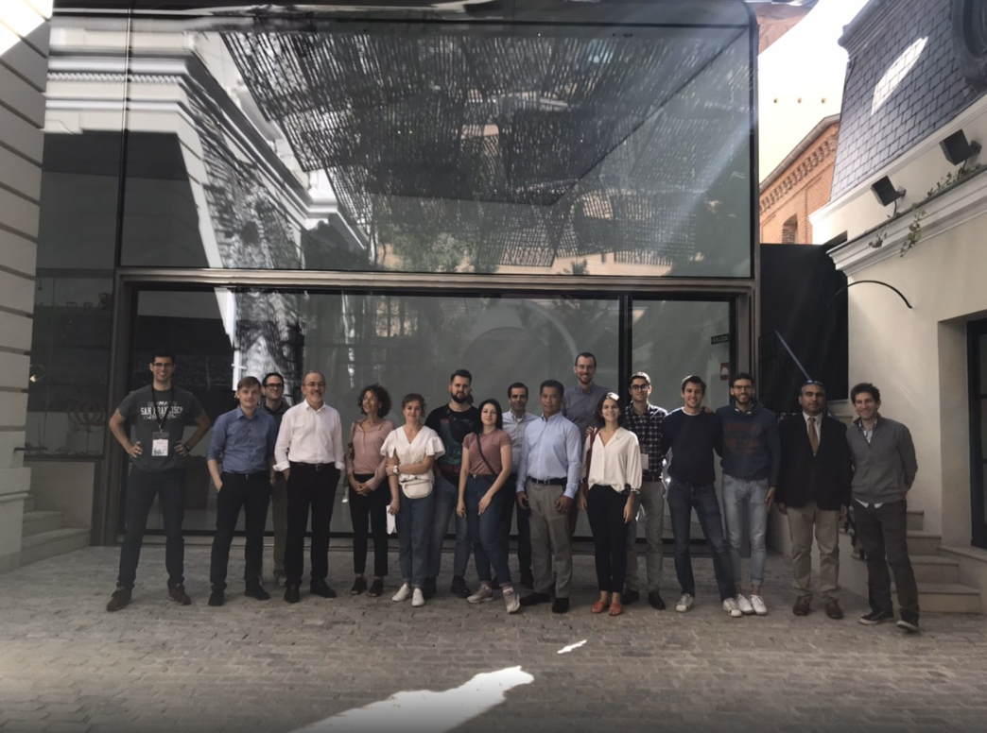
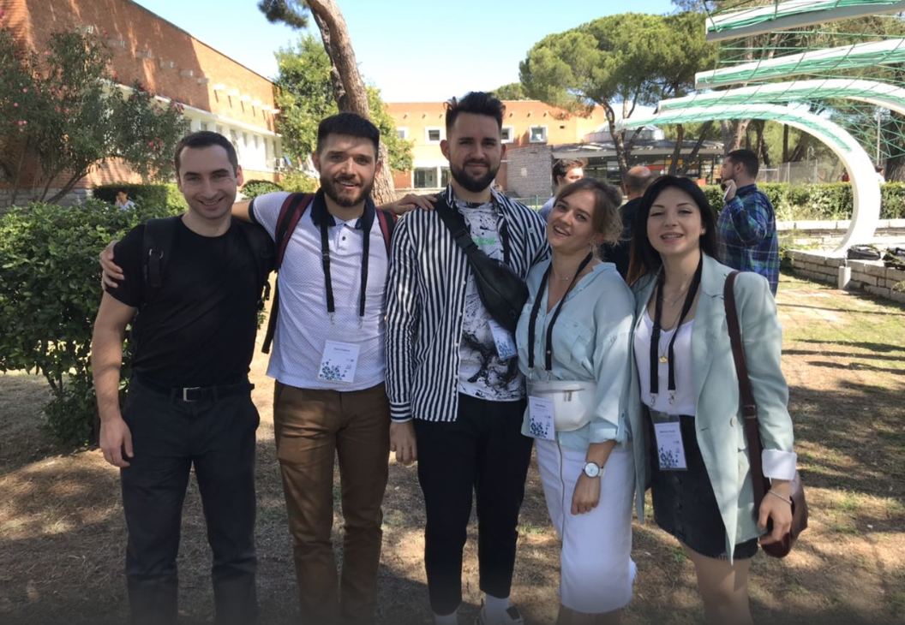
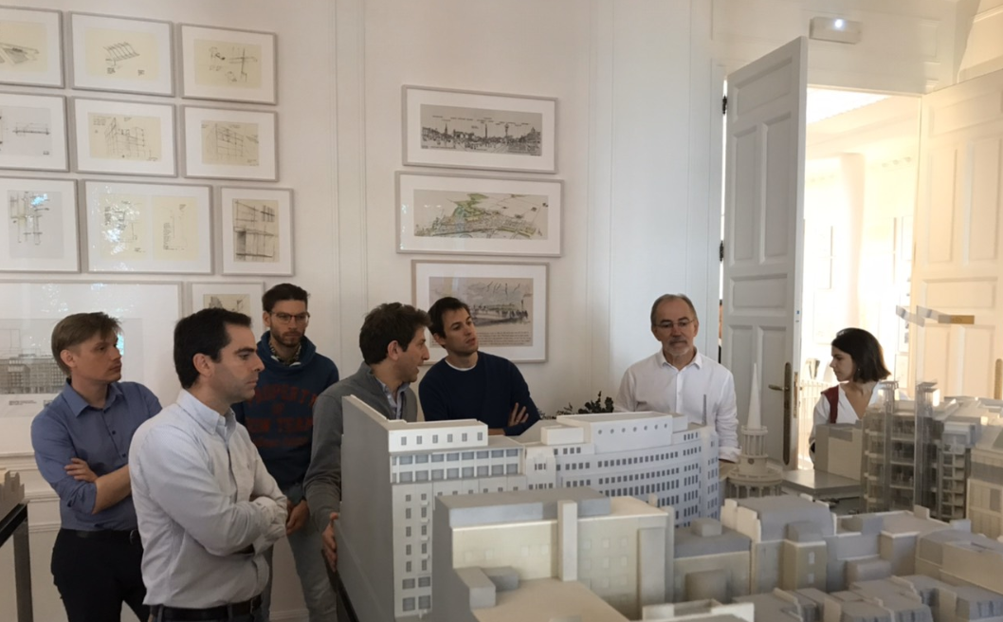
FIB Symposium of Conceptual Design in Madrid, Spain
SEPTEMBER 2019
Attendance:
5 Members – 2 Architects, 3 Civil engineers

Slide 6
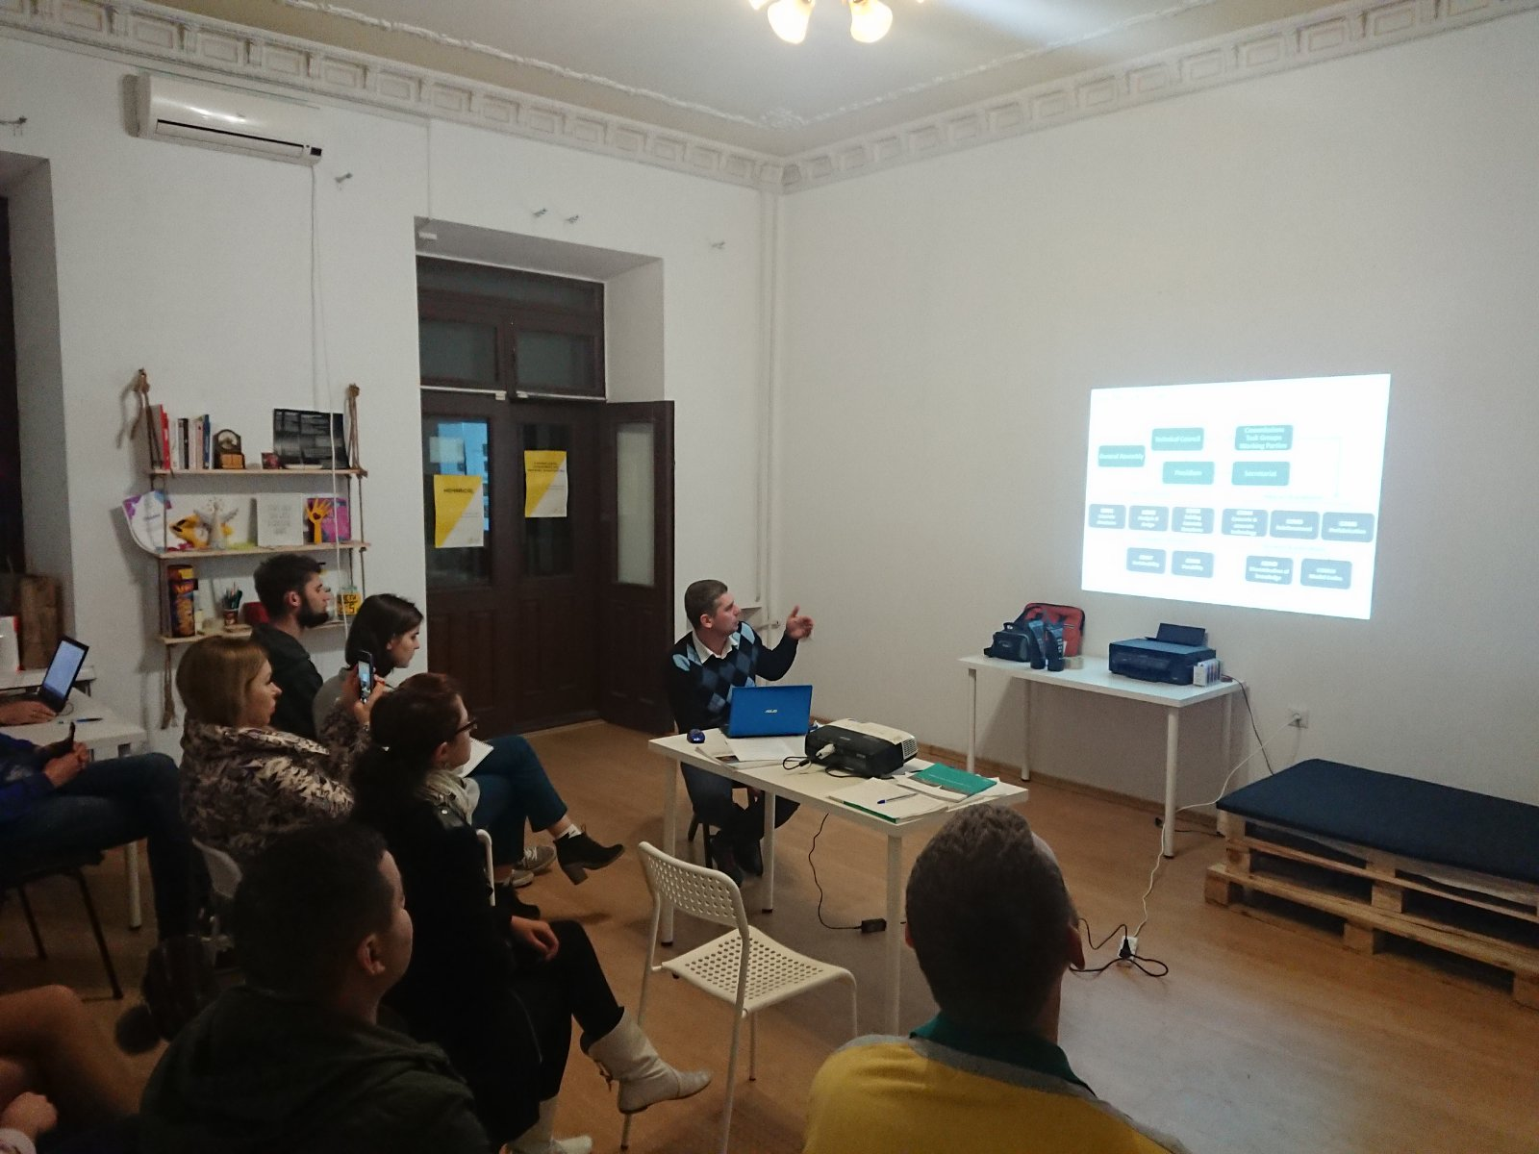
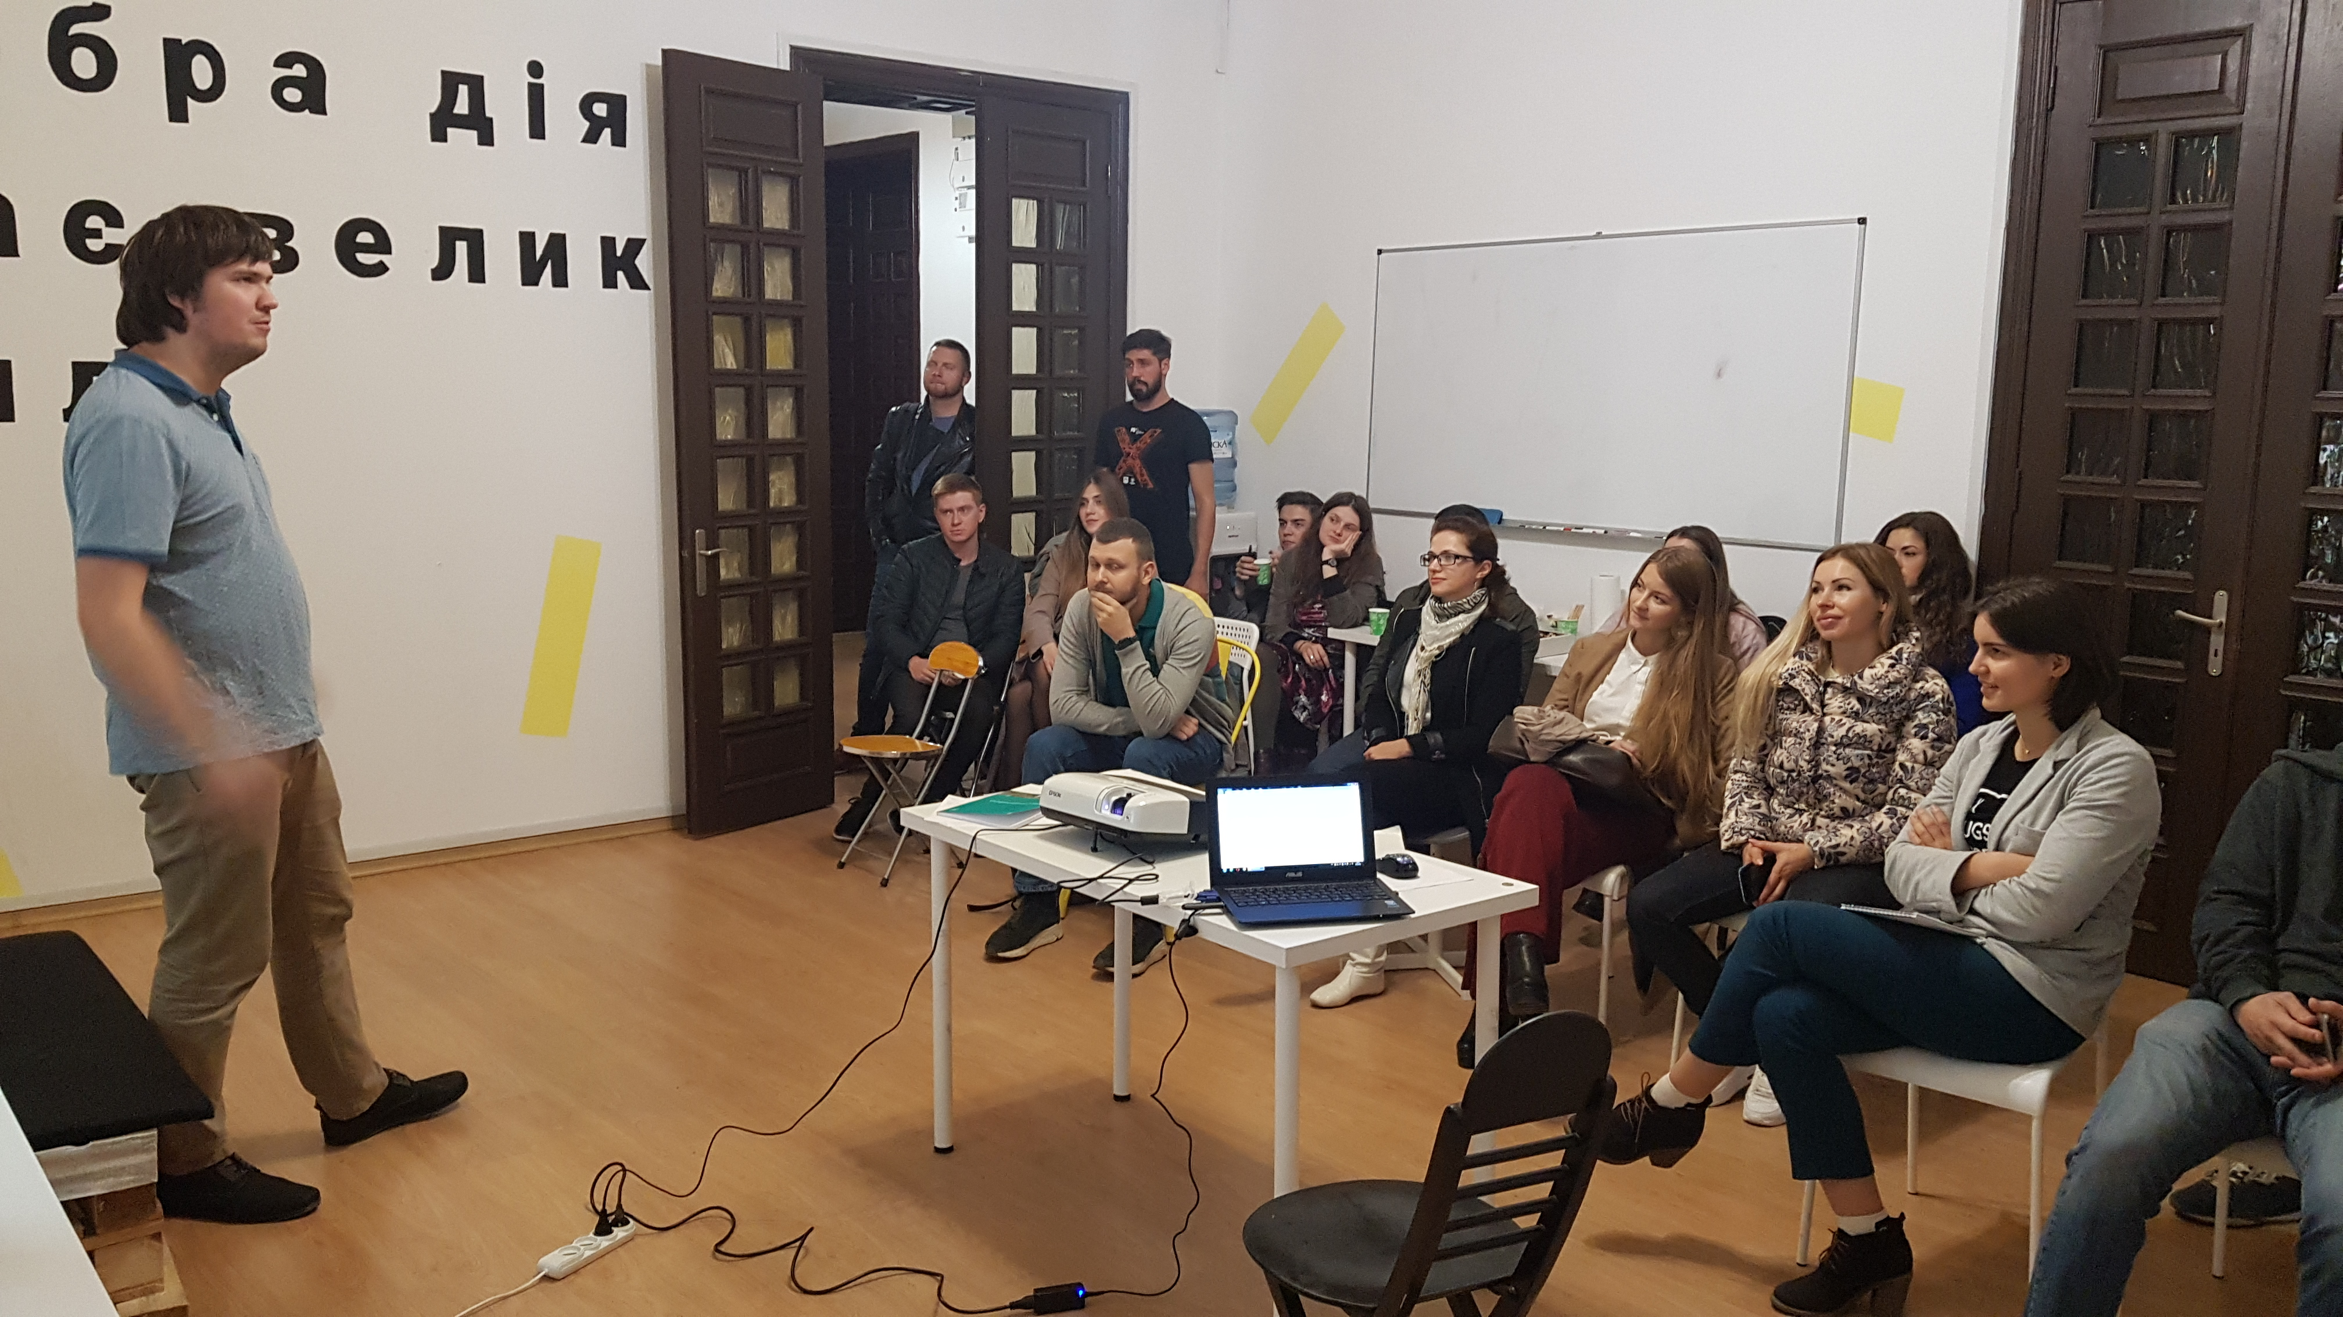
Second in-person meeting FIB YMG Ukraine (Odesa)
Topic: Concrete structures in the line of eco-development
Meeting was held in collaboration with Ukrainian Architects in the conference room of the architectural studio IMLA
Meeting format - informal communication on professional topics -
“TWO HOURS AFTER WORK”
Discussion:
Mission and goals of FIB International and fib YMG International
Green (ECO) Concrete - Green concrete. What is happening in the world and how green it can be. Based on fib Bulletin 67
Designing of hotels in the greenest region of Ukraine – Carpathians mountains – topic was presented by experienced architect head of IMLA Studio

Slide 7
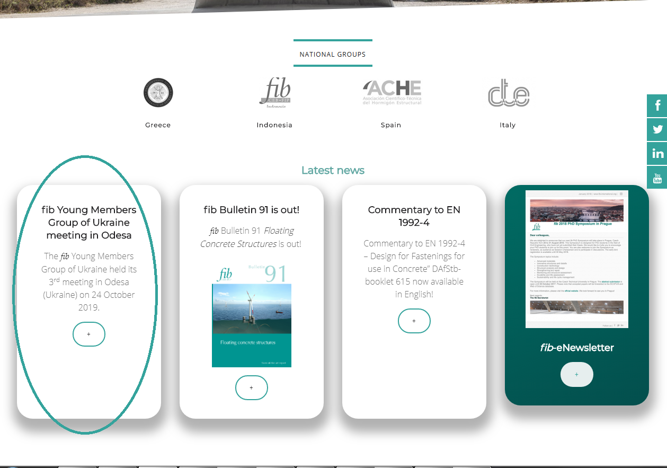
Publication on fib Website
Short essay about last meeting
https://www.fib-international.org/blog/389-fib-young-members-group-of-ukraine-meeting-in-odesa.html
Goal: to attend more members and share our activity for other young members group to improve collaboration

Slide 8
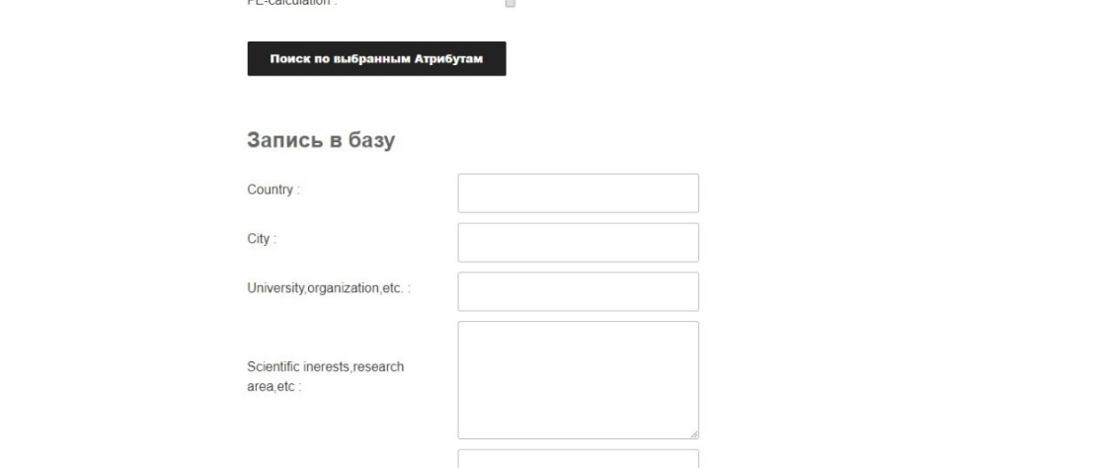
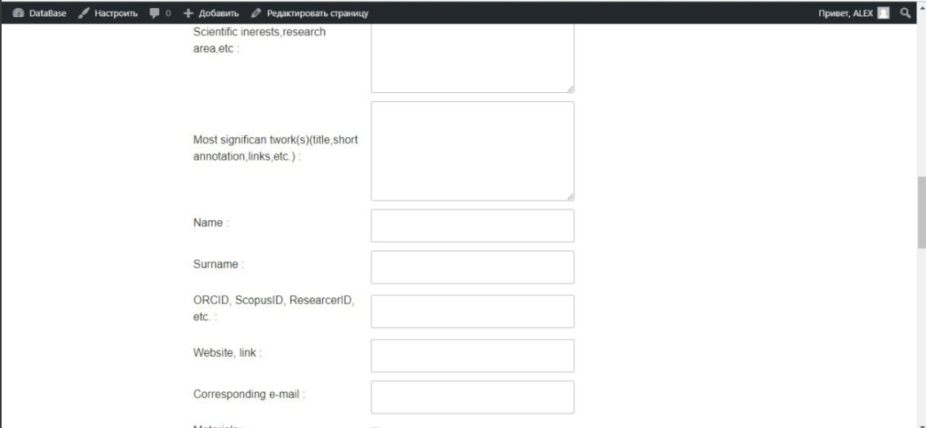
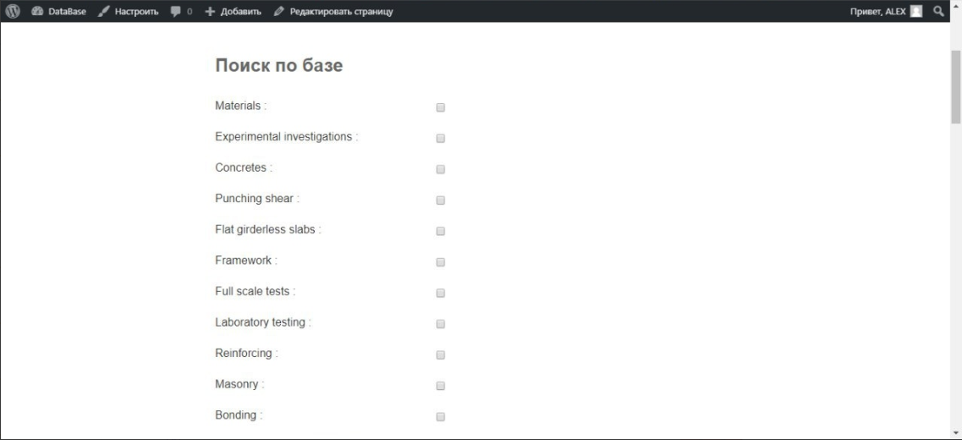
Beta version of FIB Young members Paper/Science
The idea of creation is to improve collaboration between young members from different countries to find similar science interests and work
We create a Database program for all YMG members to share their science interests and work to improve collaboration. Program runs on any server and works.
But we have problems with frontend design, if anyone could involve/help, please contact 0155544@gmail.com

Slide 9
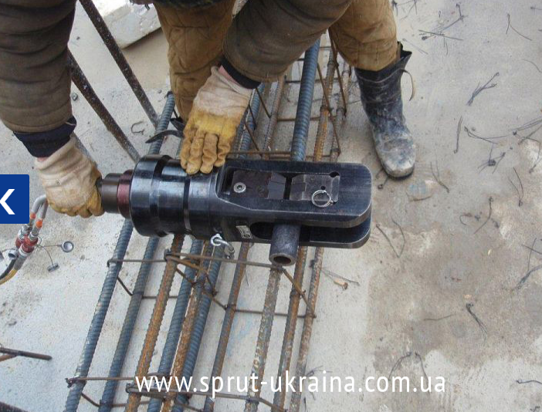
Arrangements for future work
Arrangements were made for a workshop at the factory of the SPRUT Ukraine company, which deals with the mechanical joining of reinforced bars.
Also I have arrangement about carrying out a meeting in a short formats in Odesa’s branch of the Mapei company with the theme devoted to modern methods of reinforcing reinforced concrete structures.
Those meetings were supposed to be held in November and December, but at the moment there are organizational difficulties that are associated with a lack of my time and the difficulties of coordinating time in production (for workshop). This workshop will be established at 2020

Slide 10
Arrangements for future work
For now Young members group of Ukraine has Viber and Slack community.
Viber community is the main communication channel. Slack is not so popular
YMG of Ukraine has 36 members

Slide 11
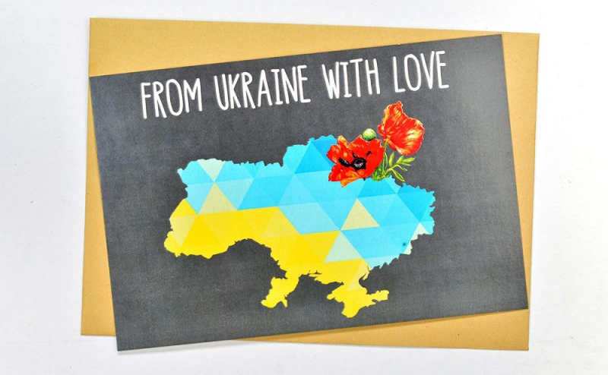
2

